Slide 1
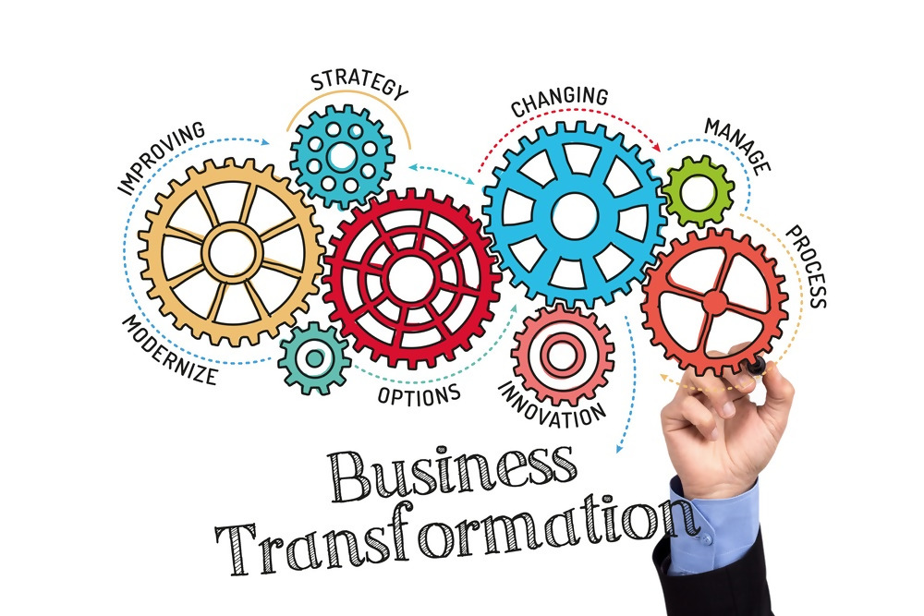
TESTING APPROACH & STRATEGY

Slide 2
Document Owner
Name | Manmeet C.
Email | mchadha9@gmail.com
Phone | +917838827099
Last Updated | Name | Comments | Accepted By

Slide 3
Approach
Testing flow summary
Testing scope and benefits
Project team – Roles and Responsibilities
Testing your product’s functionality – How ?
Choosing the right test technique
Test techniques
Choosing the right technique
Risk Based testing and Product quality
Testing levels
Test deliverables
Testing Success criteria
Defects Management
Agile vs Waterfall testing models
User testing vs Business testing
CI/CD approach
Testing forecast
Questions

Slide 4
Testing Flow… summarized
Right testing involves…
DOCUMENTATION
Entry/Exit criteria
Review Requirement
DESIRED PRODUCT
Risk Analysis
STRATEGY
Prioritize tests
Test Design
Traceability Matrix
Vision
Estimation
ITERATIONS
Test Plan Release
Defect Review
Defect Turn around
Test Iteration
DESIGNED & CODED
TIMELY
Execution Report
Defect metrics
Test
Execution
Standup
Test signoff
FINAL PRODUCT
Final Build
ORGANIZED TESTING
Refactoring
Usability
Integrated system
Working software

Slide 5
Testing Scope and Benefits
Testing Scope
To focus on features that are most intensive, frequently used, required to work by law, support business-critical processes, interact with risky aspects of a system and have been asked by stakeholders to be tested.
Identifying features such that testing completes within the timelines.
The quality characteristics to be evaluated for the product.
Different quality criteria will lead to covering different product elements and different testing techniques
This helps lower extraneous work and help concentrate on the most important elements of the software.
Ex: If in an agile model, the ‘ADD EMPLOYEE’ functionality is to be tested, the sprint scope should be decided based on the tests required by stakeholders, the scrum test team size, the estimates based on user stories included, the resources available.
Companies that failed to test their products thoroughly:
Google Plus: Nearly 500,000 users data was compromised because of the undetected bug which was present for 2+ years
Hawaii: Sends out a false Missile Alert because, they failed to test their software and the flawed design caused a panic.
Airbus: Airbus A400M crash in 2015, due to programming design flaw not caught due to lack of testing.
Multi Data Systems International: Radiation Therapy planning software unable to calculate exact dosage of radiation on patients.
Benefits of Testing:
Reduces risk of failures during operation
Builds confidence in system quality
Checks system’s compliance with requirements
Validates system’s integrated behavior as per user’s expectation
Analyses internal structure including code coverage, data storage, memory leaks
Checks performance of the system
Resources are protected from threat and data leaks
Eliminates costly changes after product go live

Slide 6








Project Team – Roles and Responsibilities
End Users
Product Owner
Conduct Alpha testing on the development site and Beta testing at some other site than the development site.
Authenticated Users: Security testing
Defines vision of the product, prioritizes needs of the user community.
Project Manager
Schedules Requirement reviews, Coordinates team meetings, Tracks project timelines, Maintains requirement traceability
Business Users
Test Manager
Creates test strategies, Mitigate Issues, Assess requirements and creates test plans, Defect management, Conducts defect tracking meetings.
Conduct business acceptance testing, Client implementation tests.
Test Engineer
Development Team
Write test cases, execute tests which includes unit testing (for some projects), smoke /sanity testing, functional testing, integration testing, performance testing and end to end testing.
Develop the architecture, Create design specifications, review stories, write code, Perform Unit Testing.

Slide 7
Testing your product’s functionality – How ?
Software testing is a way to assess the quality of the software and to reduce the risk of software failure during operation.
Choosing the right test strategy –
Static Testing
Use Cases Requirements Validation
Functional Requirements Validation
Architecture Review
Prototypes/Screen Mockup Validation
Can prevent defects in design/code by uncovering inconsistencies earlier
Increasing development productivity
Identifies defects which are not easily found by dynamic testing.
Reducing cost and time
Dynamic Testing
Functional Requirements Verification
Choosing the right technique (Black Box, White Box, Experience Based)
Test Case Design & Implementation
Features to be tested
Usecases/Test Scenarios for various flows
Trace requirements to tests (traceability)
Derive the Test Conditions
Environment requirements
Code condition
Derive the coverage Items
Derive the Test Cases
Test Execution
Defect fix verification
Static Testing
Manual examination of work products
(Reviews, inspections, walkthrough)
Dynamic Testing
Execute and check
(Identifying failures when software runs)

Slide 8
Testing Techniques
Statement Coverage
Ex: when your test execution flow touches every statement of the code
Decision Coverage
Ex: tests for decisions (if/then/else) in the code
Path Coverage
Ex: A test case that covers one complete flow from start to end.
White Box Testing
Black Box Testing
Syntax Testing
Ex: Format and the grammar of the inputs to UI
Equivalence partitioning
Ex: Condition if A between 5 and 10
Values between partition 5 and 10 will behave in an equivalent way ( the same way)
Boundary Value
Ex: Condition if A between 5 and 10
uses numbers 4, 5, 10,11 for tests
State transition testing
Ex: ATM card goes into locked state with 3 attempts of wrong password
Use case testing
Ex: specific situations cases, in which a product could be used.
Experienced Based Testing
Error Guessing
Ex: Guessing for errors in code based on experience
Exploratory based
Ex: testing adhoc all functionalities together due to lack of time
Checklist based
Ex: With experience creating a checklist of dominant features of the system, before starting to test.

Slide 9
Choosing the right technique
Depends on:
Type of the application(desktop, client-server, web/mobile, healthcare)
Type of testing required (backend database validation, front end verification, web services API testing, security, performance tests, volume tests)
System complexity (APIs exposed, white box testing tools based on language e.g CPPUnit/JUnit)
Customer requirements (web app/mobile app, load expected on the system)
Risks involved (Resource available, Lack of requirement)
Time and budget
Previous experience with similar systems
Available tools (Tool for Defect tracking, tools for white box /API tests)
Size of the product
SDLC model being followed (agile, waterfall)
Tester’s skill and knowledge (whether testers are trained for white box testing or can only do black box)

Slide 10
Risk-based Testing and Product Quality
MITIGATION
Project Issues
Political Issues
Right Planning
Ex:
Delays in delivery, task completion.
Inaccurate estimates.
Late changes resulting in substantial re-work.
Ex:
Testers may not communicate test results adequately
Developers and/or testers weak interaction.
Ex:
Prioritizing risks.
Determining test techniques and test extent required.
Contingency plans to deal with risks should they become actual events.
Technical issues
Organizational Issues
Right Testing
Ex:
Un availability of required tools.
Requirements not clearly defined.
Ex:
Skills, training, and staff may not be sufficient.
Users, business staff, or SMEs not be available due to conflicting
Priorities.
Ex:
Testing used as risk mitigation activity to provide feedback about identified risks, as well as providing feedback on residual (unresolved) risks.
RISKS

Slide 11



Functional Testing Levels
Unit Testing
01
IntegrationTesting
Checking behavior of the integrated modules.
Ex: PL/SQL procedure unit tested with appropriate input/output parameters.
‘Add Employee’ page testing as a separate unit.
02
Ex: In a payroll application, integrating and testing modules for reimbursements, proof of investments and payment runs.
Sanity Testing
Ensuring the product is capable of being
tested.
03
Regression Testing
Ex: Able to move to next window with valid username and password on clicking submit button.
Checking unintended side-effects due to
code change.
Ex: Payroll application modified for tax inclusions. The complete payment run process to be tested for any side effects.
04
Security Testing
Uncovering vulnerabilities of the system
05
Ex: Securing user account identities.
Hiding sensitive data from attackers
Performance Testing
Loading the system artificially to check
performance
06
End to End Testing
Verifying application flow from start to end
Ex: University website behavior when results announced.
Ex: In a payroll application, testing end to end flow of modules for employee registration, employee salary details, activating employees, running payroll and maintaining payroll history.
07
User Acceptance Testing
Validating the fitness for use of the
system by the users
08
Ex: Beta testing done by end users on a different site

Slide 12
Test Deliverables
Test Strategy
Test Plan
Test Design
Defect Reports
Test Sign off
Test Strategy
Test Plan
Test Design
Defect Reports
Sign Off
Provides a generalized description of the test process
Outlines test activities based on test policy, test strategy, scope of testing, objectives, risks and availability of resources.
Prioritizing test scripts
Identifying test data
Designing test environment
Identifying infrastructure/tools
Creating traceability
Reporting software failures
Severity of the issue
Stage of the defect
Expected behavior
Sending out approval about the test exit criteria being achieved

Slide 13
Entry/Exit criteria of testing
Criteria for a successful test cycle
Entry Criteria - Definition of being ready for testing.
Exit Criteria - Definition of being done with testing.
Criteria are defined during the test planning phase.
Sign offs from various teams qualifies the criteria to be met.
Members involved in identifying entry/exit criteria:
Business Analysts
Business Users
Product Manager
Development Manager
Test Manager
Release Manager
Entry Criteria
Testing of AUT
(Application Under Test)
Exit Criteria
Requirements defined
Test Execution completed
Testable code
Sufficient requirements
tested
Test Cases developed
No critical defects
Test Data available
Desired functionality
achieved
Environment readiness
Test sign off

Slide 14
Defects Management
Defect Severity
(For an e-commerce site)
Defect Priority
(For an e-commerce site)
Defect Life Cycle
(Stages of a defect)
New
(When tester raises a new defect)
Assigned To Developer
(When tester assigns the defect to a developer)
Pending Test
(After defect is fixed and assigned back to tester)
Test Failed
(When test for defect fix fails and defect assigned back to developer
Rejected
(When developer rejects the defect)
Cancelled
(When tester cancels the defect)
Closed
(After defect fix is tested successfully)
Critical
(e.g. System crash, server not responding)
Major
(e.g. quantity of items in cart is not right)
Moderate
(e.g. Search feature not working right)
Minor
( e.g Apply coupon button requires double click)
Cosmetic
(e.g. Spelling mistake, alignment issue)
High
(e.g. System crash, server not responding)
(e.g. quantity of items in cart is not right)
Medium
(e.g. Search feature not working right)
Low
( e.g Apply coupon button requires double click)
(e.g. Spelling mistake, alignment issue)

Slide 15
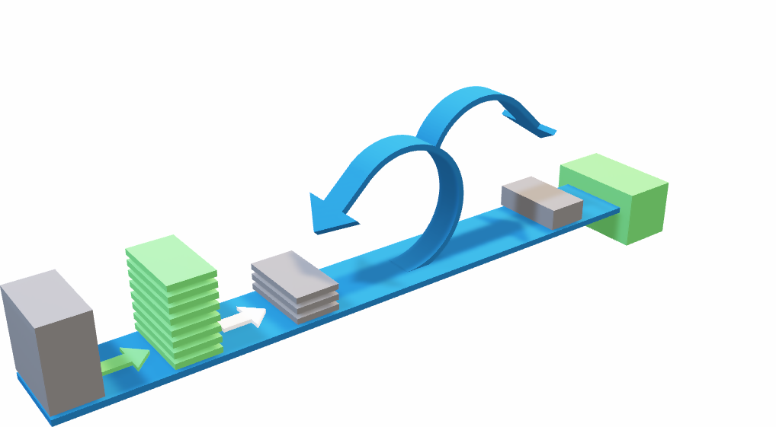
Waterfall Testing Model
Agile vs Waterfall testing models
Agile Testing Model
Daily Scrum
Sprint
1-4 Weeks
Finished
Work
Requirement Analysis
Sprint Planning Meeting
Testing
System Design
Product Backlog
Implementation
Coding
System Testing
Product Increment
Maintenance
Sprint
Backlog

Slide 16
User Testing vs Business Testing
User Testing
Focuses on functional scenarios, tasks and user goals.
Measures performance with users.
Scope is performance and user experience.
BUSINESS TESTING
USER TESTING
Business Testing
Focuses on business processes using real life test cases.
Measures end customer’s preference
Scope is user’s preference, concept, idea and ease of use.

Slide 17
User Testing vs Business Testing
User Testing
Focuses on scenarios, tasks and user goals.
Measures performance with users.
Scope is performance and user experience.
VALUE
USER TESTING
BUSINESS TESTING
Business Testing
Focuses on concept, idea or prototype.
Measures end customer’s preference
Scope is user’s preference, concept, idea and ease of use.

Slide 18
Continuous Integration and Continuous Delivery
SOURCE
BUILD
DELIVER
TEST
Depends on - proper branching (integration branch/release branch), daily check-ins, regular tests
Continuous Integration - practice where code is integrated frequently on the integration branch
(Ex: integration branch committed/merged )
Continuous Delivery/Deployment - process of keeping the application in production ready state, changes frequently deployed to production in an agile manner.
(Ex: prep/provision code unit/build tests deploy test runtime)
Steps
Source – Proper branching, Source code check-in, Peer review
Build – Code coverage, Compile, Unit Test
Test – Integration, Load, UI test etc.
Deliver – Deployment to Production

Slide 19
Testing forecast
The detailed requirement analysis/review for the product and the test resource availability/expertise, are the main driving factors for forecasting a product’s test timelines.
Depends on:
Stage of the product’s life cycle
Requirement complexity
Business Users demand
Testing technique used
Testing types involved
Team size
SDLC model
Risks involved
Step 5
Step 4
Step 3
June 1st to November 30th
Step 2
Oct 1st to Oct 31st
Nov 1st to Nov 30th
Complete Test Cycle
Step 1
Sep 1st to Sep 30th
July 1st to August 31st
User Acceptance
Testing
Unit
&
Integration
Testing
Regression
Testing
E2E/ Performance/Security
Testing
Test
Planning

Slide 20
Questions
Questions before starting:
Type of application (Web, Client Server Applications, Mobile application)
Is the SDLC methodology being followed
High Level project timelines
Defect tracking tool to be used
What is the current status of the project?
What is the start date?
What is the End Date?
Who are the developers?
Who are the Testers?
Who will create the test data?
Who will sign-off on the test Scripts?
What is the current Development process?
What are some Risks we should be mindful of?
What types of access would we require in order to log-in to the portal?
Is there data migration?
What are your pain points?
Are there any other applications that your module is dependent on?

Slide 21

ANY THOUGHTS?!

